Slide 1
Intro to ASP.NET Core
Spencer Schneidenbach
@schneidenbach
spencer@avironsoftware.com
Notes:
Slide deck originally by Jon Galloway

Slide 2


ASP.NET Core and the Modern Web
Totally Modular
Faster Development Cycle
Seamless transition from on-premises to cloud
Choose your Editors
and Tools
Open Source with Contributions
OSS
Cross-Platform
Fast

Slide 3
Hosting

Slide 4
Middleware

Slide 5
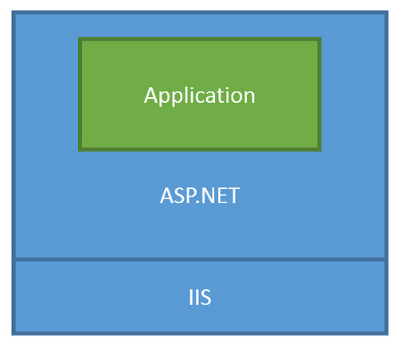
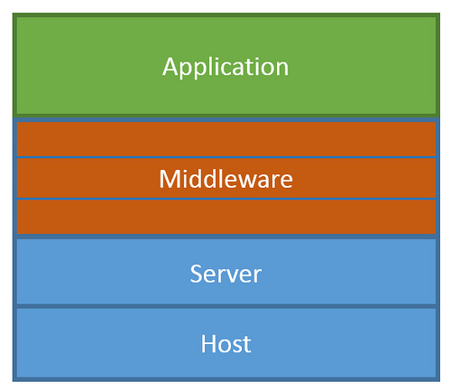
ASP.NET Core Middleware
Traditional ASP.NET Application Model
ASP.NET Core Middleware

Slide 6
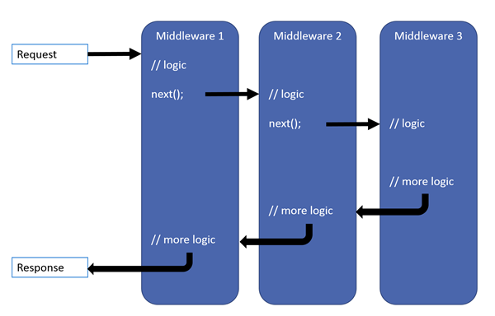
ASP.NET Core Middleware

Slide 7
Configuration

